Slide 1
SPRING VALLEY VILLAGE POLICE DEPARTMENT
MONTHLY NEWSLETTER:
FEBRUARY 2025
1025 CAMPBELL ROAD
HOUSTON, TX 77055
PHONE: 713-465-8323
COMMUNITY MATTERS.
WE ARE A TEAM.

Slide 2
INTRODUCTION
Hilshire Village Residents,
We hope the new year is off to a good start and everyone is enjoying the warmer weather. Scams usually increase with the beginning of the new year. We want to remind everyone to remain vigilant against phishing attempts. Beware of anyone claiming you owe money because you missed jury duty. The Court system will not contact you by phone or email.
Never provide your personal information, Social Security number, bank account information, or credit card numbers to anyone who calls and asks for it unless you are certain of who you are dealing with. Remember that government agencies do not accept payment via gift cards. Below are a few more things to keep in mind while you go about your daily activities. As always, we are available whenever you have concerns.
KEEP IN MIND:
Be sure to lock all doors and windows in your home, when you are not on the premises.
Lock your vehicle when it is unoccupied.
Be cautious while in and around our school zones
Sincerely,
Chief M. Schulze
COMMUNITY MATTERS.
WE ARE A TEAM.
1025 CAMPBELL ROAD, HOUSTON, TX 77055
PHONE: 713-465-8323 / EMAIL: DISPATCH@SPRINGVALLEYTX.COM

Slide 3
FEBRUARY 2025
DATE | DAY | SPECIAL DAYS FOR THIS MONTH
02-14-2025 | FRIDAY | VALENTINE’S DAY
02-17-2025 | MONDAY | PRESIDENT’S DAY
COMMUNITY MATTERS.
WE ARE A TEAM.
1025 CAMPBELL ROAD, HOUSTON, TX 77055 / PHONE: 713-465-8323 / EMAIL: DISPATCH@SPRINGVALLEYTX.COM

Slide 4
PPublic Service Announcement (PSA) From Our Officers:
Spring Valley Village PD offers a House Watch Program for residents while away on vacation during the holidays. Either call Dispatch or email the form found in this newsletter and on the Police Department website.
Lt. A. Menchaca
Please pay attention to school buses loading and unloading children during the morning and afternoon. When the school bus is stopped and the red lights are flashing, motorists must stop. Also pay attention to school zones and crosswalks. Let’s all do our part for the safety of our children.
Sgt. T. Wood
When you call in an emergency be sure to stay on the line and be as calm as possible. Answer all questions. Give the dispatcher your address or describe your location, giving landmarks when possible.
TCO B. Williams
COMMUNITY MATTERS.
WE ARE A TEAM.
1025 CAMPBELL ROAD, HOUSTON, TX 77055 / PHONE: 713-465-8323 / EMAIL: DISPATCH@SPRINGVALLEYTX.COM

Slide 5
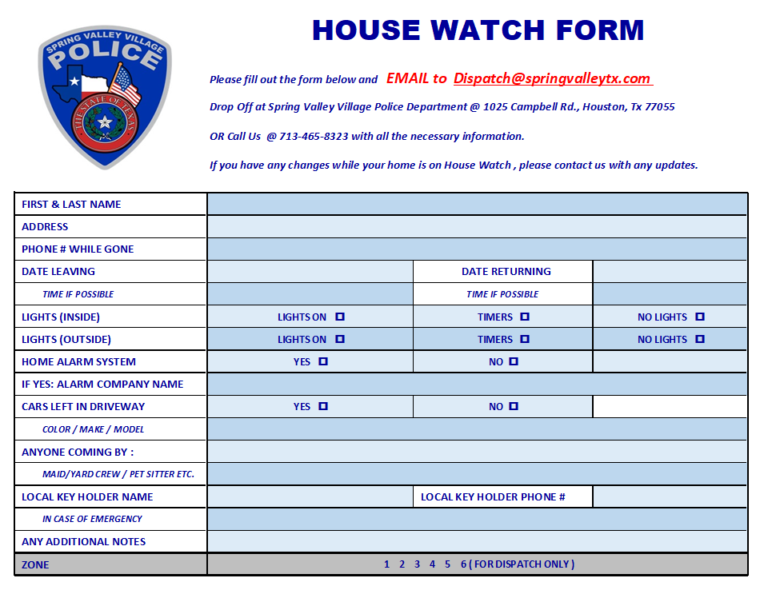
TIPS TO PREP BEFORE LEAVING
Close windows, blinds, curtains, shutters, lock all doors and garage.
Set timers on interior lights. This goes a long way in deterring burglars, who often look for crimes of opportunity.
Set your thermostat accordingly, for unnecessary energy cost, but can also help avoid unforeseen problems with you HVAC equipment.
Take out the trash.
Run garbage disposal until clear.
Secure all valuables.
Lock all vehicles that are at home.
Turn on home security system.
Arrange for pets left at home.

Slide 6
IDENTITY THEFT
What are the 3 types of identity theft?
Financial Identity Theft
Medical Identity Theft
Online Identity Theft
Identity theft, also known as identity fraud, is a crime in which an imposter obtains key pieces of personally identifiable information (PII), such as Social Security or driver's license numbers, to impersonate someone else.
COMMUNITY MATTERS.
WE ARE A TEAM.
1025 CAMPBELL ROAD, HOUSTON, TX 77055
PHONE: 713-465-8323 / EMAIL: DISPATCH@SPRINGVALLEYTX.COM

Slide 7
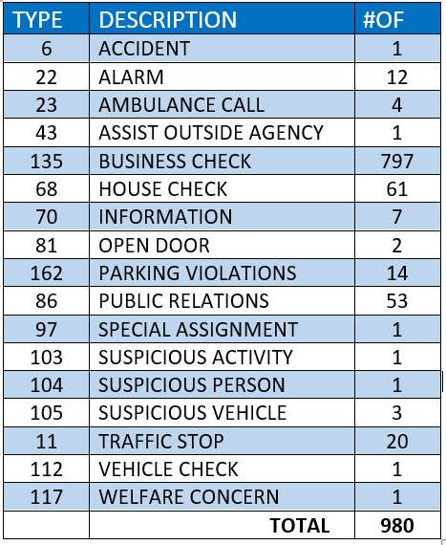
SPRING VALLEY POLICE DEPARTMENT
HILSHIRE VILLAGE
CALLS BY TYPE: 01/01/2025 THRU 01/31/2025
COMMUNITY MATTERS.
WE ARE A TEAM.
1025 CAMPBELL ROAD, HOUSTON, TX 77055
PHONE: 713-465-8323 / EMAIL: DISPATCH@SPRINGVALLEYTX.COM

Slide 8
IMPORTANT NUMBERS AT A GLANCE
EMERGENCY |  | NON - EMERGENCY
911 - FOR ALL EMERGENCY |  | 713-465-8323
988 – NATIONAL SUICIDE & MENTAL HEALTH
SPRING VALLEY VILLAGE |  | VILLAGE FIRE DEPARTMENT
SPRING VALLEY - CITY HALL | 713-465-8308 | VILLAGE FIRE DEPARTMENT |  | 713-465-2323
SPRING VALLEY - PD | 713-465-8323 | VFD - NON-EMERGENCY |  | 713-468-7941
SPRING VALLEY - PD FAX | 713-465-3135
SPRING VALLEY - COURT | 713-465-0333
HILSHIRE VILLAGE
HILSHIRE VILLAGE – CITY HALL | 713-973-1779
COMMUNITY MATTERS.
WE ARE A TEAM.
1025 CAMPBELL ROAD, HOUSTON, TX 77055 / PHONE: 713-465-8323 / EMAIL: DISPATCH@SPRINGVALLEYTX.COM

