Slide 1


SPRING VALLEY VILLAGE POLICE DEPARTMENT
MONTHLY NEWSLETTER:
DECEMBER 2024
1025 CAMPBELL ROAD
HOUSTON, TX 77055
PHONE: 713-465-8323
COMMUNITY MATTERS.
WE ARE A TEAM.

Slide 2

INTRODUCTION
Hilshire Village Residents,
Traditionally, the holiday season is a festive time of year. It is also a time when people are busy and become vulnerable to theft and other holiday crime. We will continue our patrols in an effort to keep thieves out of the area.
Remember, while out shopping to always; think about where you are and check the area to see who may be watching (especially when at the ATM). Double check your vehicle to ensure it is locked, and upon returning to your car quickly enter your car, lock the doors and make sure that everything is still there.
Best wishes for a Merry Christmas and a magnificent New Year.
Sincerely,
Chief M. Schulze
COMMUNITY MATTERS.
WE ARE A TEAM.
1025 CAMPBELL ROAD, HOUSTON, TX 77055
PHONE: 713-465-8323 / EMAIL: DISPATCH@SPRINGVALLEYTX.COM

Slide 3



DECEMBER 2024
DATE | DAY | SPECIAL DAYS FOR THIS MONTH
DECEMBER 07, 2024 | SATURDAY | PEARL HARBOR REMEMBRANCE DAY
DECEMBER 21, 2024 | SATURDAY | FIRST DAY OF WINTER (DECEMBER SOLSTICE)
DECEMBER 24, 2024 | TUESDAY | CHRISTMAS EVE (CITY HALL CLOSED)
DECEMBER 25, 2024 | WEDNESDAY | CHRISTMAS DAY (CITY HALL CLOSED)
DECEMBER 31, 2024 | TUESDAY | NEW YEAR’S EVE
COMMUNITY MATTERS.
WE ARE A TEAM.
1025 CAMPBELL ROAD, HOUSTON, TX 77055 / PHONE: 713-465-8323 / EMAIL: DISPATCH@SPRINGVALLEYTX.COM

Slide 4
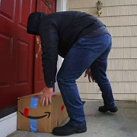
Public Service Announcements (PSA) From Our Officers
December is the month for increased delivery of packages. Thieves “Porch Pirates” are aware of this. Keep an eye on tracking updates and try to be home when packages arrive. A weatherproof lockbox is a great way to keep packages safe until you can grab them. Let’s watch out for each other during this holiday season.
Be aware of distraction crimes. If approached by someone representing a utility company, make sure you observe or ask for credentials. If you did not call the utility company do not allow anyone in your home to check for water or gas leaks. Thieves will attempt to distract in order to enter your home for the purpose of theft. Stay vigilant and report any unusual or suspicious activity in your neighborhood. Your awareness can help ensure the safety of your community.
We wish you all a safe and joyous holiday season!
Sergeant C. Spriggs
COMMUNITY MATTERS.
WE ARE A TEAM
1025 CAMPBELL ROAD, HOUSTON, TX 77055 / PHONE: 713-465-8323 / EMAIL: DISPATCH@SPRINGVALLEYTX.COM

Slide 5
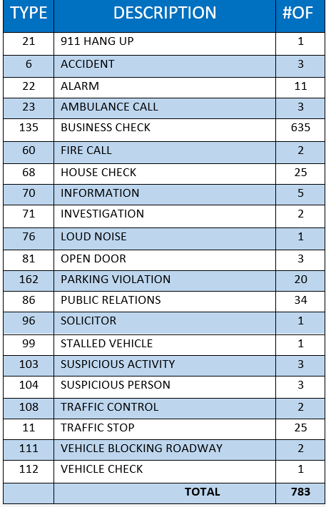
SPRING VALLEY POLICE DEPARTMENT
HILSHIRE VILLAGE
CALLS BY TYPE: 11/01/24 THRU 11/30/24
COMMUNITY MATTERS.
WE ARE A TEAM.
1025 CAMPBELL ROAD, HOUSTON, TX 77055
PHONE: 713-465-8323 / EMAIL: DISPATCH@SPRINGVALLEYTX.COM

Slide 6
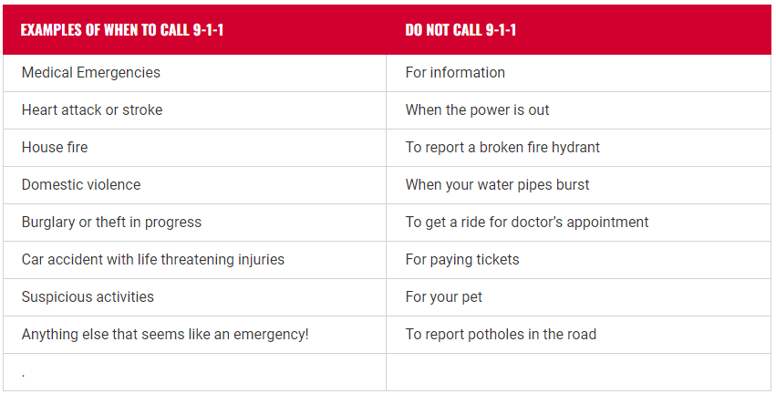


Public Service Announcement (PSA) From Our Dispatchers:
When should you call 9-1-1?
COMMUNITY MATTERS.
WE ARE A TEAM.
1025 CAMPBELL ROAD, HOUSTON, TX 77055
PHONE: 713-465-8323 / EMAIL: DISPATCH@SPRINGVALLEYTX.COM

Slide 7
IMPORTANT NUMBERS AT A GLANCE
EMERGENCY |  | NON - EMERGENCY
911 - FOR ALL EMERGENCY |  | 713-465-8323
988 – NATIONAL SUICIDE & MENTAL HEALTH
SPRING VALLEY VILLAGE |  | VILLAGE FIRE DEPARTMENT
SPRING VALLEY - CITY HALL | 713-465-8308 | VILLAGE FIRE DEPARTMENT |  | 713-465-2323
SPRING VALLEY - PD | 713-465-8323 | VFD - NON-EMERGENCY |  | 713-468-7941
SPRING VALLEY - PD FAX | 713-465-3135
SPRING VALLEY - COURT | 713-465-0333
HILSHIRE VILLAGE
HILSHIRE VILLAGE – CITY HALL | 713-973-1779
COMMUNITY MATTERS.
WE ARE A TEAM.
1025 CAMPBELL ROAD, HOUSTON, TX 77055 / PHONE: 713-465-8323 / EMAIL: DISPATCH@SPRINGVALLEYTX.COM

Slide 8

COMMUNITY MATTERS.
WE ARE A TEAM.
1025 CAMPBELL ROAD, HOUSTON, TX 77055
PHONE: 713-465-8323 / EMAIL: DISPATCH@SPRINGVALLEYTX.COM

