Slide 1
SPRING VALLEY VILLAGE POLICE DEPARTMENT
MONTHLY NEWSLETTER:
SEPTEMBER 2024
1025 CAMPBELL ROAD
HOUSTON, TX 77055
PHONE: 713-465-8323
COMMUNITY MATTERS.
WE ARE A TEAM.

Slide 2
INTRODUCTION
Hilshire Village Residents,
Fall will soon be here, which will bring us cooler weather and some rain. As school is back in session, please be mindful of school zones and school buses.
KEEP IN MIND:
Be sure to lock all doors and windows in your home, when you are not on the premises.
Lock your vehicle when it is unoccupied.
Take all valuables out of your vehicle.
As always we are here if you need us!
Sincerely,
Chief M. Schulze
1025 CAMPBELL ROAD, HOUSTON, TX 77055
PHONE: 713-465-8323 / EMAIL: DISPATCH@SPRINGVALLEYTX.COM

Slide 3
SEPTEMBER 2024
DATE | DAY | SPECIAL DAYS FOR THIS MONTH
09-02-2024 | MONDAY | LABOR DAY
09-02-2024 | MONDAY | CITY HALL CLOSED
09-22-2024 | SUNDAY | FIRST DAY OF FALL
COMMUNITY MATTERS.
WE ARE A TEAM.
1025 CAMPBELL ROAD, HOUSTON, TX 77055 / PHONE: 713-465-8323 / EMAIL: DISPATCH@SPRINGVALLEYTX.COM

Slide 4
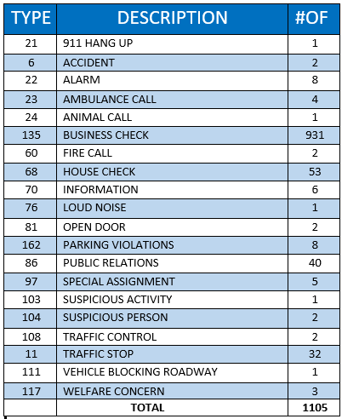
SPRING VALLEY POLICE DEPARTMENT
HILSHIRE VILLAGE
CALLS BY TYPE: 08-01-2024 THRU 08-31-2024
COMMUNITY MATTERS.
WE ARE A TEAM.
1025 CAMPBELL ROAD, HOUSTON, TX 77055
PHONE: 713-465-8323 / EMAIL: DISPATCH@SPRINGVALLEYTX.COM

Slide 5
Safety Tips: Phone Scams
What You Need to Know About Phone Scams
Have you ever received a call from someone who purported to be a law enforcement or government agent who said you were about to be arrested for outstanding traffic fines or back taxes unless you immediately wired money to pay the fines? Or have you received calls offering to rebuild your credit or relieve your debts; Such calls seek your money or information about your identity by making promises or threats and they are almost always bogus. As preposterous as these offers or threats sound, phone scammers bilk billions of dollars annually from unwitting Americans. These crooks typically research you through your social media accounts (another reason to protect your privacy on-line!) so their calls sound creditable. The following basic rules can protect you from identity theft:
1.If an offer sounds too good to be true, it may be a scam.
2.Law enforcement and government agents do not conduct their business, solicit money, or make threats over the telephone.
3.Scammers will pressure you to make an immediate decision and won’t want to send documentation.
4.There is never a good reason to mail cash or a gift card to unknown callers.
Here are some things you can do to stop calls from scammers:
Hang up!
Get on the Do Not Call Registry. Go to www.donotcall.gov to sign up.
Consider a call-blocking app for your phone.
Don’t trust your caller ID. Scammers can make any name and number show up on your caller ID. This strategy is called “spoofing.”
Copy the number of the scammer and any other information you obtain and send it to the Federal Trade Commission: www.reportfraud.ftc.gov. You can also sign up for email updates at www.ftc.gov/scams.
Detective Clay Spriggs
COMMUNITY MATTERS.
WE ARE A TEAM.
1025 CAMPBELL ROAD, HOUSTON, TX 77055 / PHONE: 713-465-8323 / EMAIL: DISPATCH@SPRINGVALLEYTX.COM

Slide 6
Safety Tips:
COMMUNITY MATTERS.
WE ARE A TEAM.
1025 CAMPBELL ROAD, HOUSTON, TX 77055 / PHONE: 713-465-8323 / EMAIL: DISPATCH@SPRINGVALLEYTX.COM

Slide 7
SPRING VALLEY POLICE DEPARTMENT
COMMUNITY MATTERS.
WE ARE A TEAM.
1025 CAMPBELL ROAD, HOUSTON, TX 77055
PHONE: 713-465-8323 / EMAIL: DISPATCH@SPRINGVALLEYTX.COM

Slide 8
IMPORTANT NUMBERS AT A GLANCE
EMERGENCY |  | NON - EMERGENCY
911 - FOR ALL EMERGENCY |  | 713-465-8323
988 – NATIONAL SUICIDE & MENTAL HEALTH
SPRING VALLEY VILLAGE |  | VILLAGE FIRE DEPARTMENT
SPRING VALLEY - CITY HALL | 713-465-8308 | VILLAGE FIRE DEPARTMENT |  | 713-465-2323
SPRING VALLEY - PD | 713-465-8323 | VFD - NON-EMERGENCY |  | 713-468-7941
SPRING VALLEY - PD FAX | 713-465-3135
SPRING VALLEY - COURT | 713-465-0333
HILSHIRE VILLAGE
HILSHIRE VILLAGE – CITY HALL | 713-973-1779
COMMUNITY MATTERS.
WE ARE A TEAM.
1025 CAMPBELL ROAD, HOUSTON, TX 77055 / PHONE: 713-465-8323 / EMAIL: DISPATCH@SPRINGVALLEYTX.COM

